Slide 1


An Introduction to
for Satellite Remote Sensing
TC Chakraborty
Earth Scientist
Pacific Northwest National Lab
Observing Earth from Space
Apr 28, 2022

Slide 2
Background & Need
Data Types & Models
Examples
JavaScript API + Code Editor
Example Workflow
Web Applications
Resources
____
Outline

Slide 3
Background & Need
Data Types & Models
Examples
JavaScript API + Code Editor
Example Workflow
Web Applications
Resources
____

Slide 4
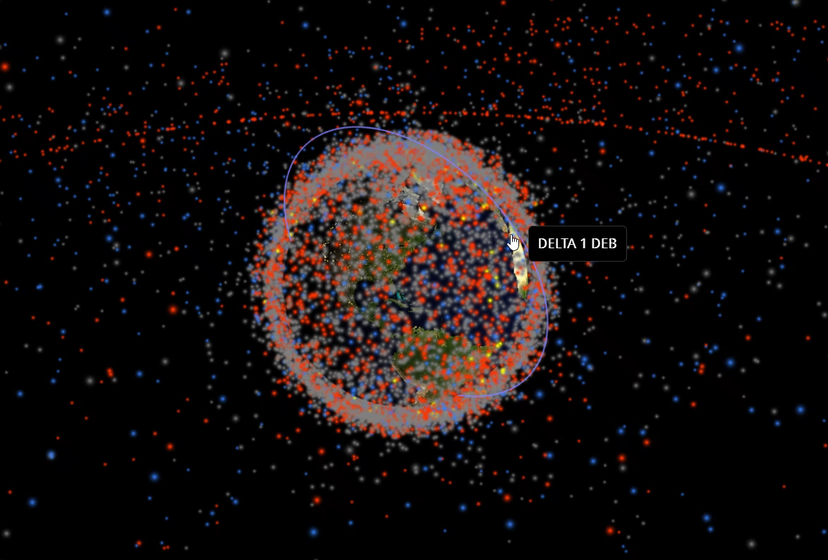
Explosion of Data
http://stuffin.space/

Slide 5
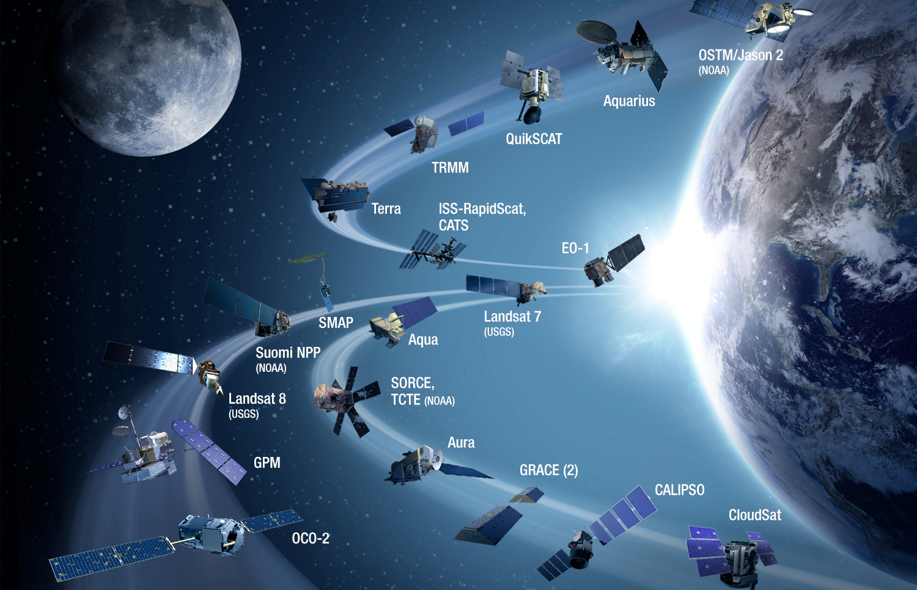
NASA Earth Observing System Data and Information System (EOSDIS)
12.1 TB of data per day
Source: NASA

Slide 6
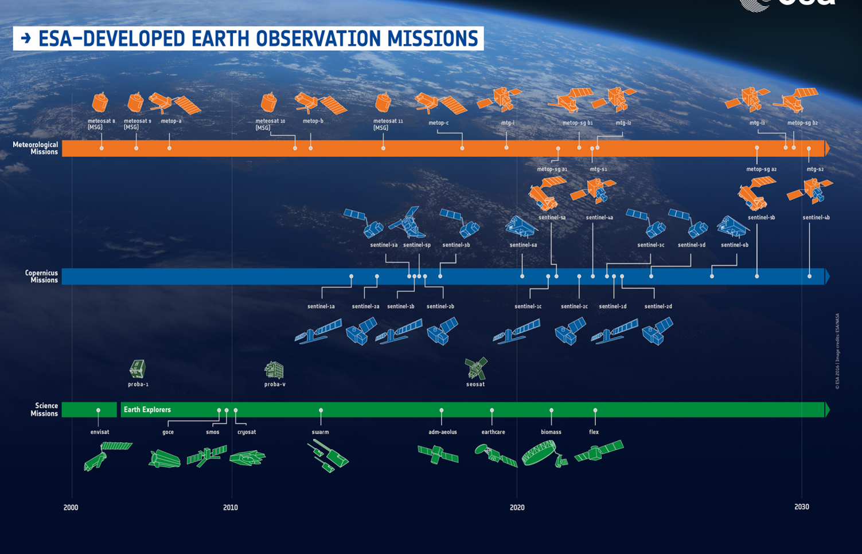
Copernicus (Sentinel)
150 TB of data per day
Source: ESA

Slide 7
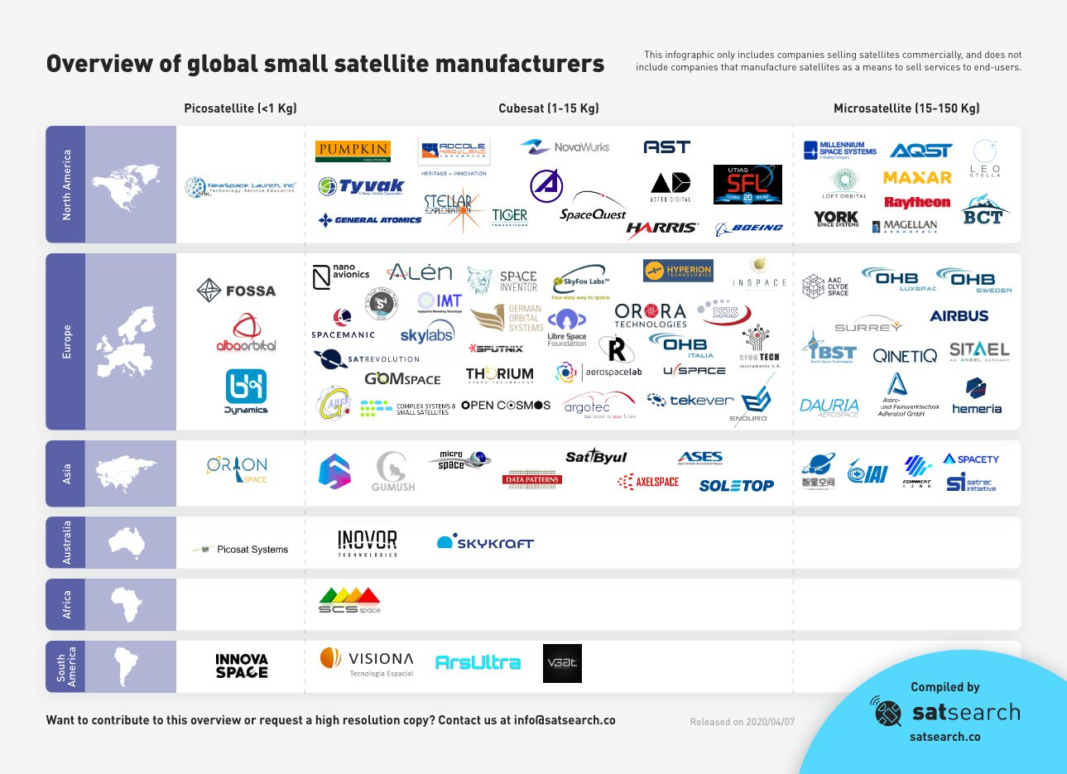
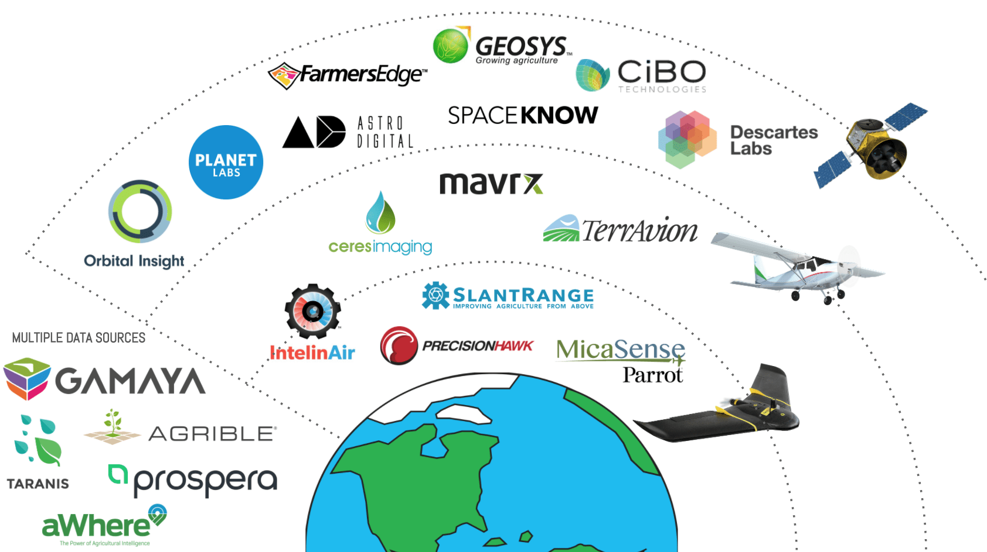
Private Companies
Private Companies

Slide 8

-Jim Gray (1944-2007)
“Often it turns out to be more efficient to move the questions than to move the data.”

Slide 9
> 20 Petabytes of Earth observation data (imagery, weather, etc.)
https://developers.google.com/earth-engine/datasets/

Slide 10

Google computational infrastructure

Slide 11
Background
Data Types & Models
Examples
JavaScript API + Code Editor
Example Workflow
Web Applications
Resources
____

Slide 12
Vector data
Vector data represent objects on the Earth's surface using their longitude and latitude, as well as combinations of the pairs of coordinates (lines, polylines, polygons, etc.).
Raster data
Raster data represent objects/variables on the Earth's surface as a matrix of values, in the form of pixels, cells, or grids.

Slide 13

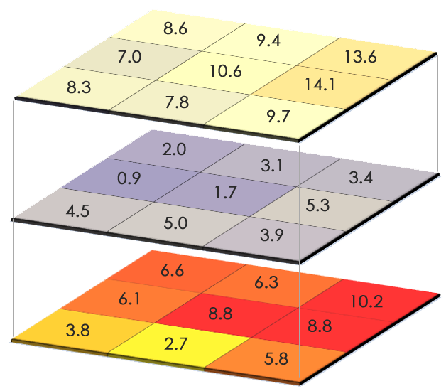

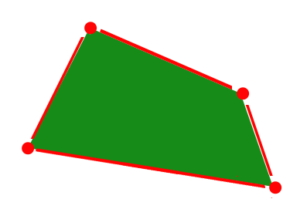
Vector Data Raster Data

Slide 14
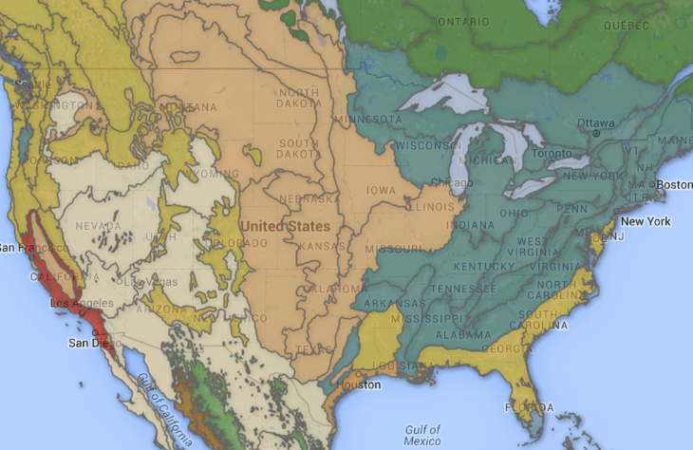
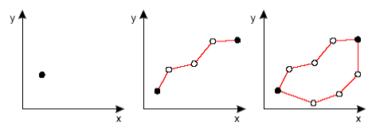
Data Models
Geometry
Line / Point / Polygon vectors
and their combinations
TNC Ecoregions

Slide 15
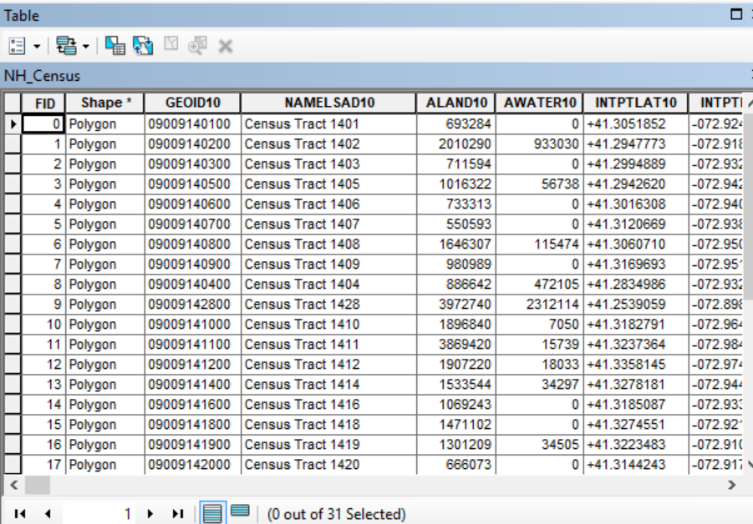
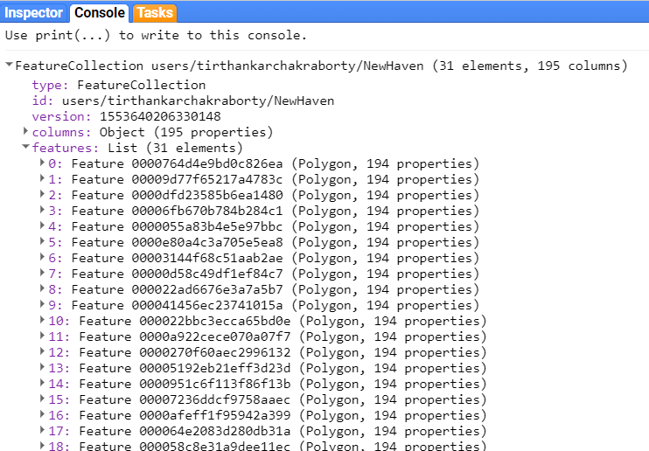
Data Models
Geometry
Feature
Geometry with
lists of Properties
ArcMap
Google Earth Engine

Slide 16
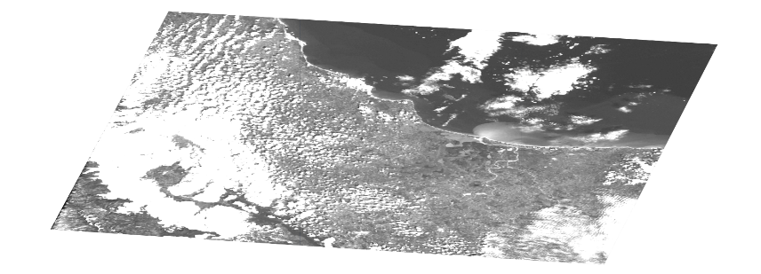
Data Models
Geometry
Feature
Image
Stack of Georeferenced bands
Each band has its own:
Mask, Projection, Resolution
A list of properties, including:
Date, Bounding-box

Slide 17

Data Models
Geometry
Feature
Image
Collection
Bag of Elements
Table of Features
Directory of Images
Group of Geometries

Slide 18
Sign-up
earthengine.google.com/signup

Slide 19
Background
Data Types & Models
Examples
JavaScript API + Code Editor
Example Workflow
Web Applications
Resources
____

Slide 20
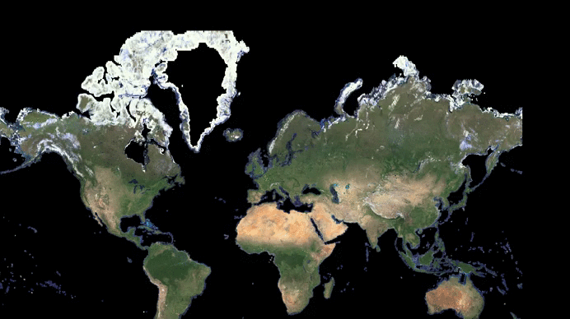

Slide 21
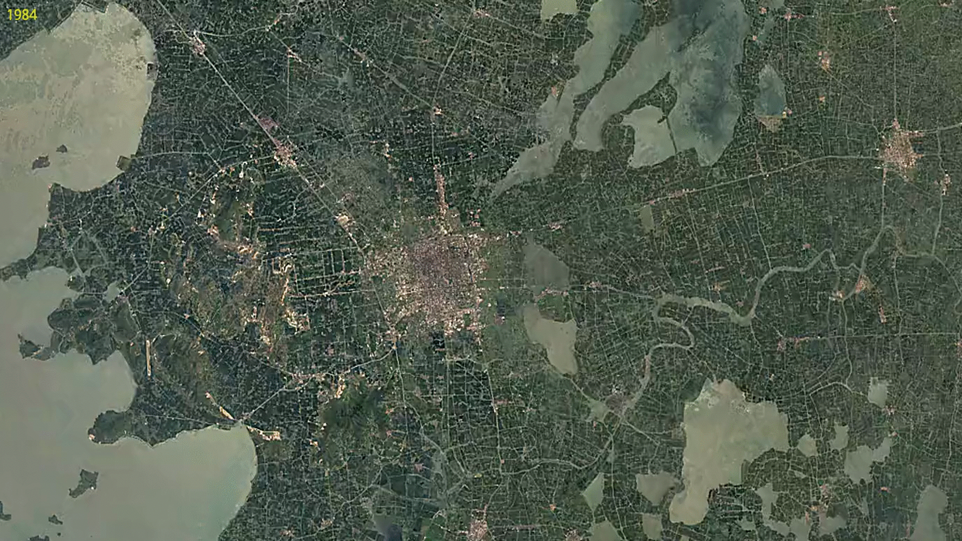
Notes:
Urbanization in Suzhou, China.

Slide 22
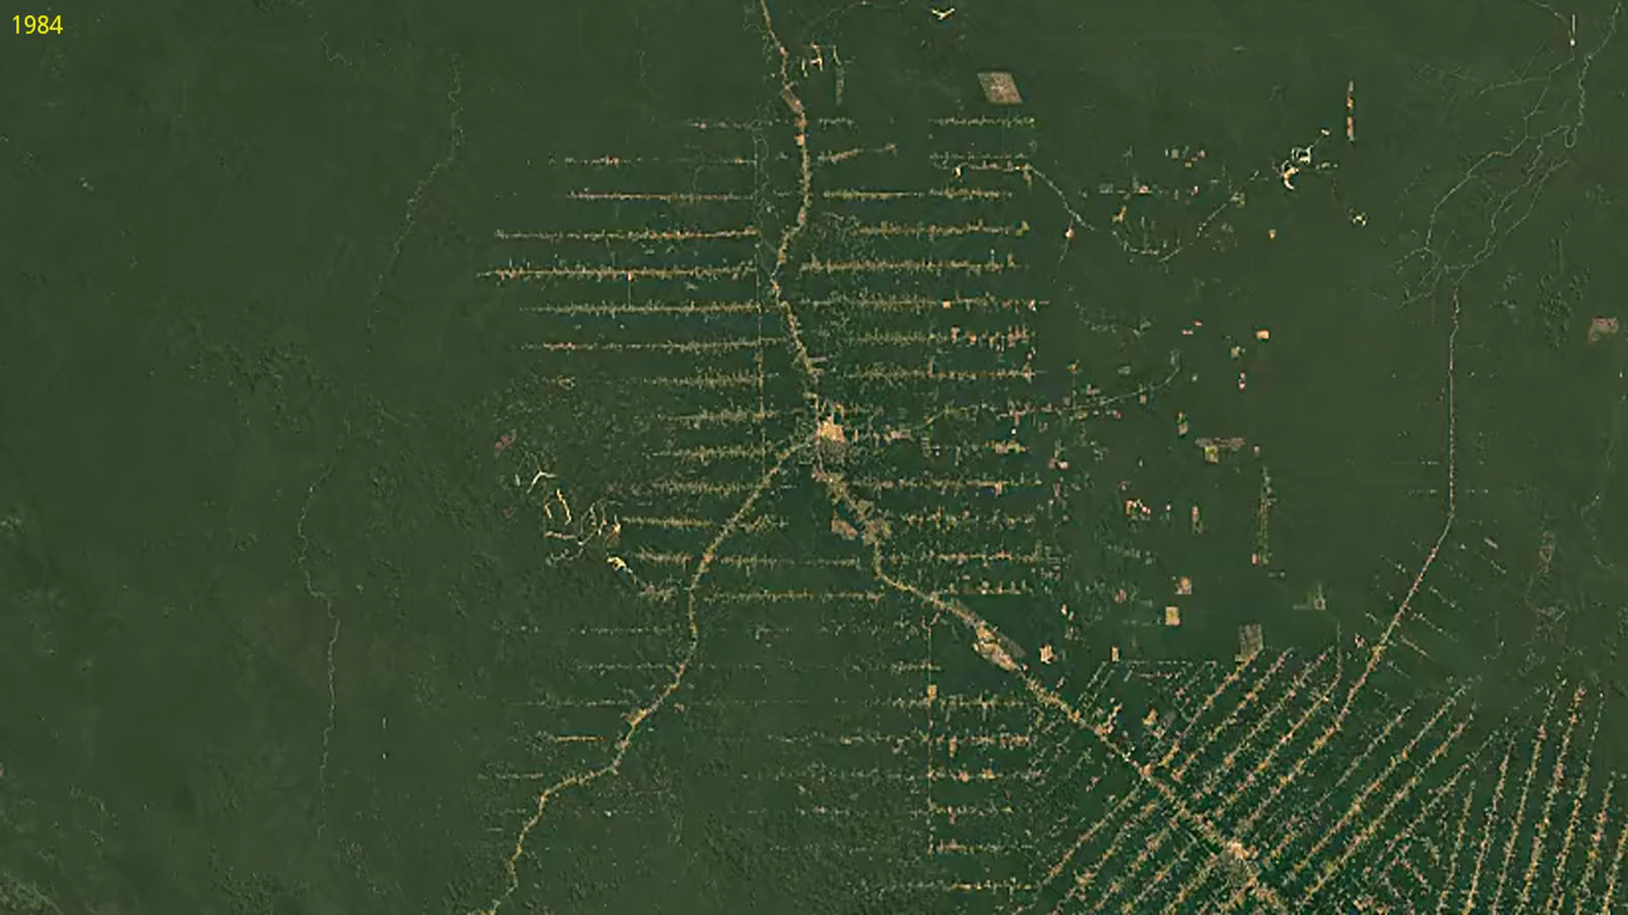
https://earthengine.google.com/timelapse/
Notes:
Amazon deforestation.

Slide 23
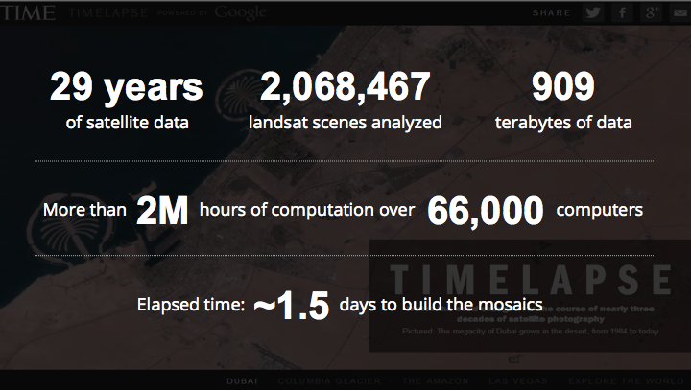

Slide 24
Background
Data Types & Models
Examples
JavaScript API + Code Editor
Example Workflow
Web Applications
Resources
____

Slide 25
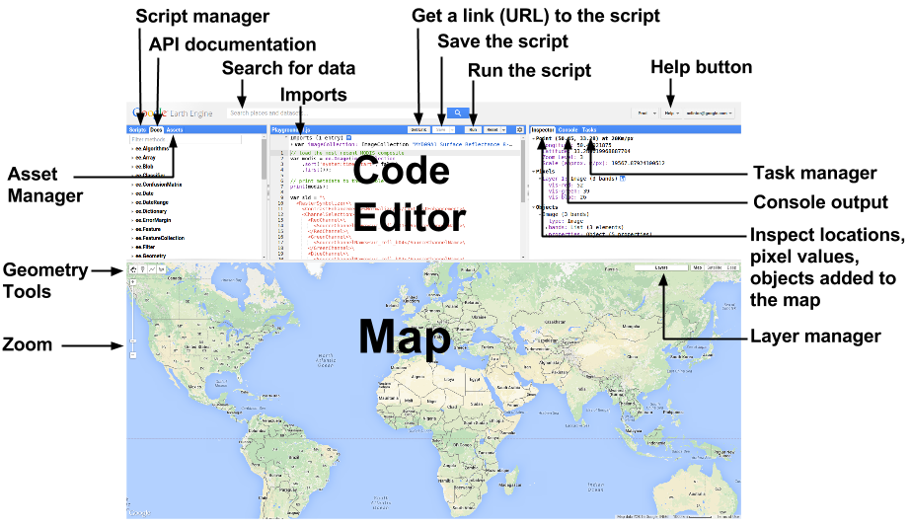
Will be introduced
later on...

Slide 26
JavaScript in 60 Seconds
// All the javascript you need to know (almost) var number = 1 var string = 'Hello, World!' var list = [1.23, 8, -3] print(list[2]) var dictionary = { a: 'Hello', b: 10, c: 0.1343, d: list } print(dictionary.b) print(number, string, list, dictionary)
Script link
And the fun stuff
Mapping
Reducing
Workflows

Slide 27
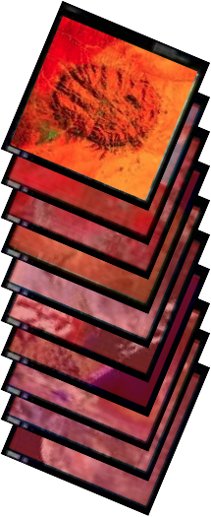
Map
Mapping
Apply a function to each element of a collection
A "map" (for-each) operation
Examples
Compute area of each feature
Cloud cover of each image
Mosaic for each month

Slide 28

Reduce
Aggregate everything in a collection
based on a function
"Reduction"
Examples
Summed area over all features
Median-pixel composite
Any statistical summary

Slide 29
Background
Data Types & Models
Examples
JavaScript API + Code Editor
Example Workflow
Web Applications
Resources
____

Slide 30
Basic workflow
Importing a Region of Interest
Importing ImageCollection
Filtering an ImageCollection
Selecting bands
Masking
Reduce Region and Mapping
Visualization (Map)
Exporting Output
Script link for local scale analysis and data extraction
Script link for global change detection

Slide 31
Background
Data Types & Models
Examples
JavaScript API + Code Editor
Example Workflow
Web Applications
Resources
____

Slide 32
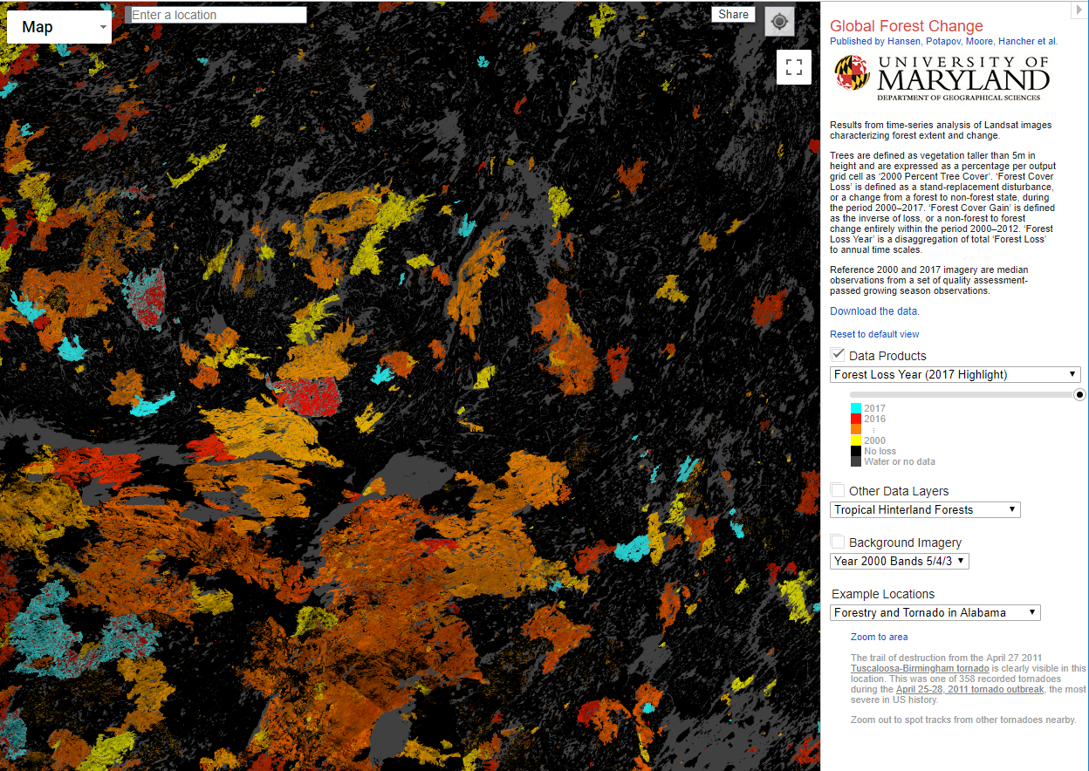

Slide 33
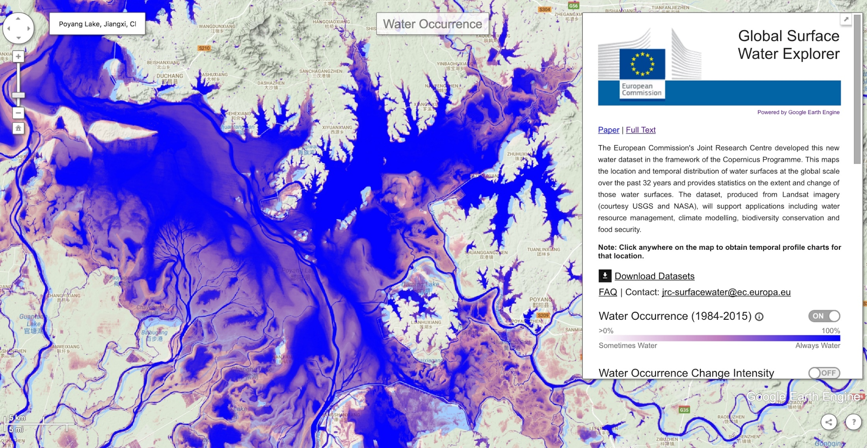

Slide 34
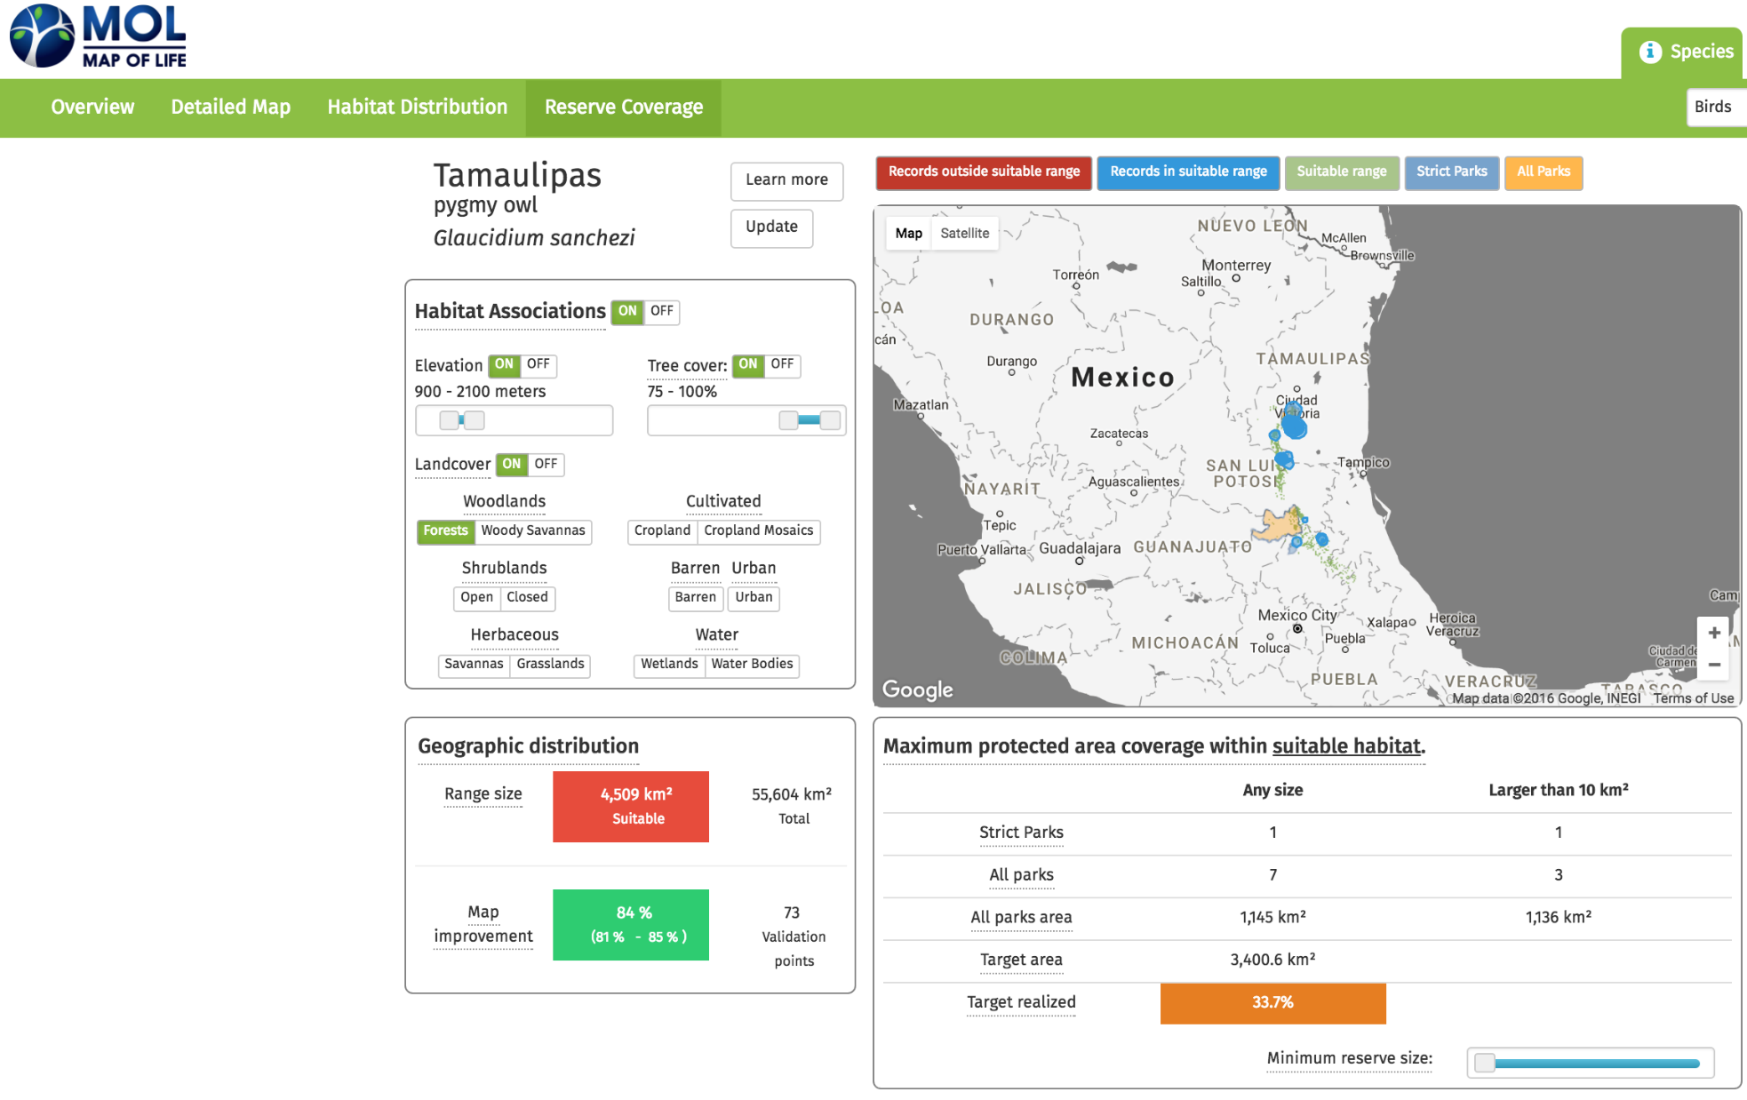

http://mol.org/

Slide 35
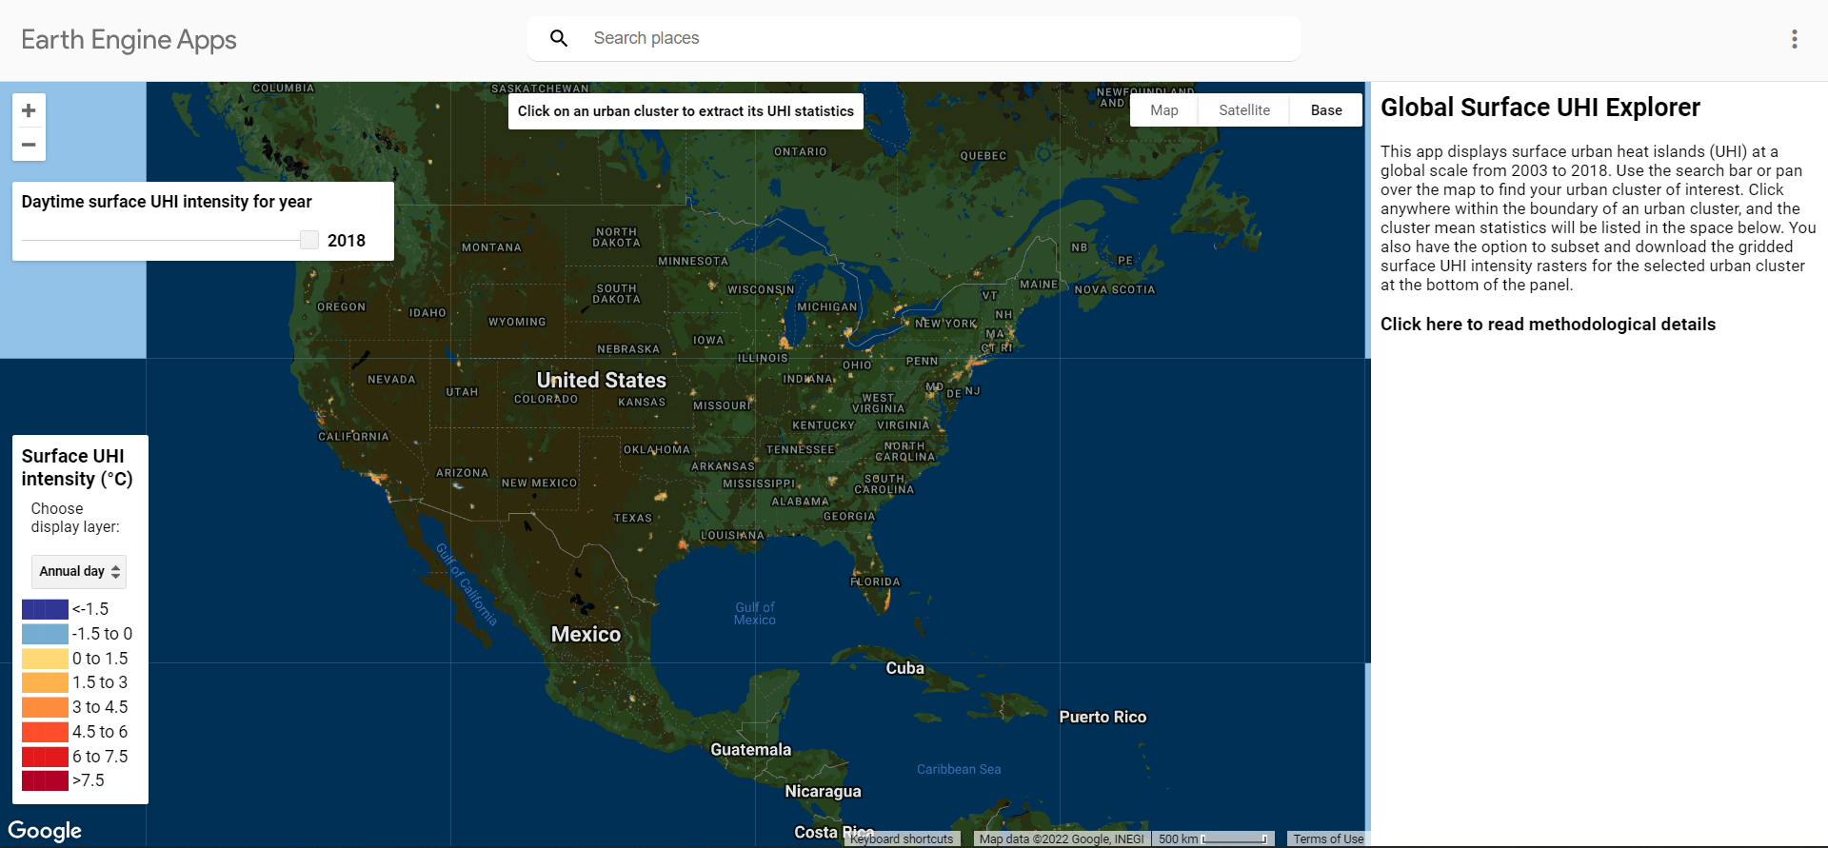
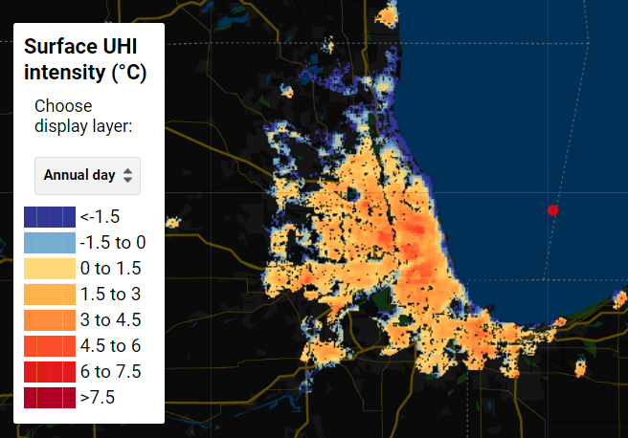
https://yceo.users.earthengine.app/view/uhimap

Slide 36
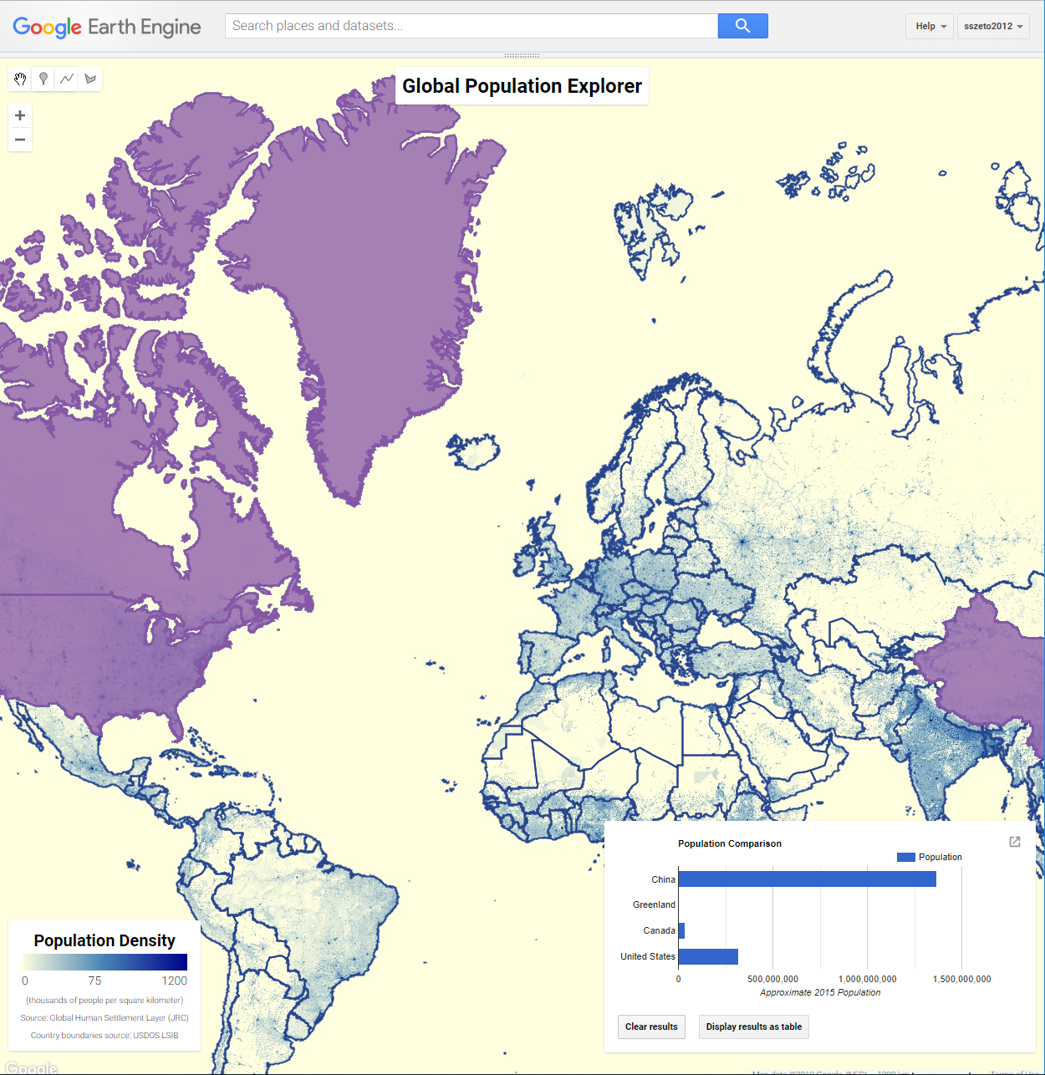
https://code.earthengine.google.com/2f18d4535ae92fac79d3e0cb42f9ee02

Slide 37
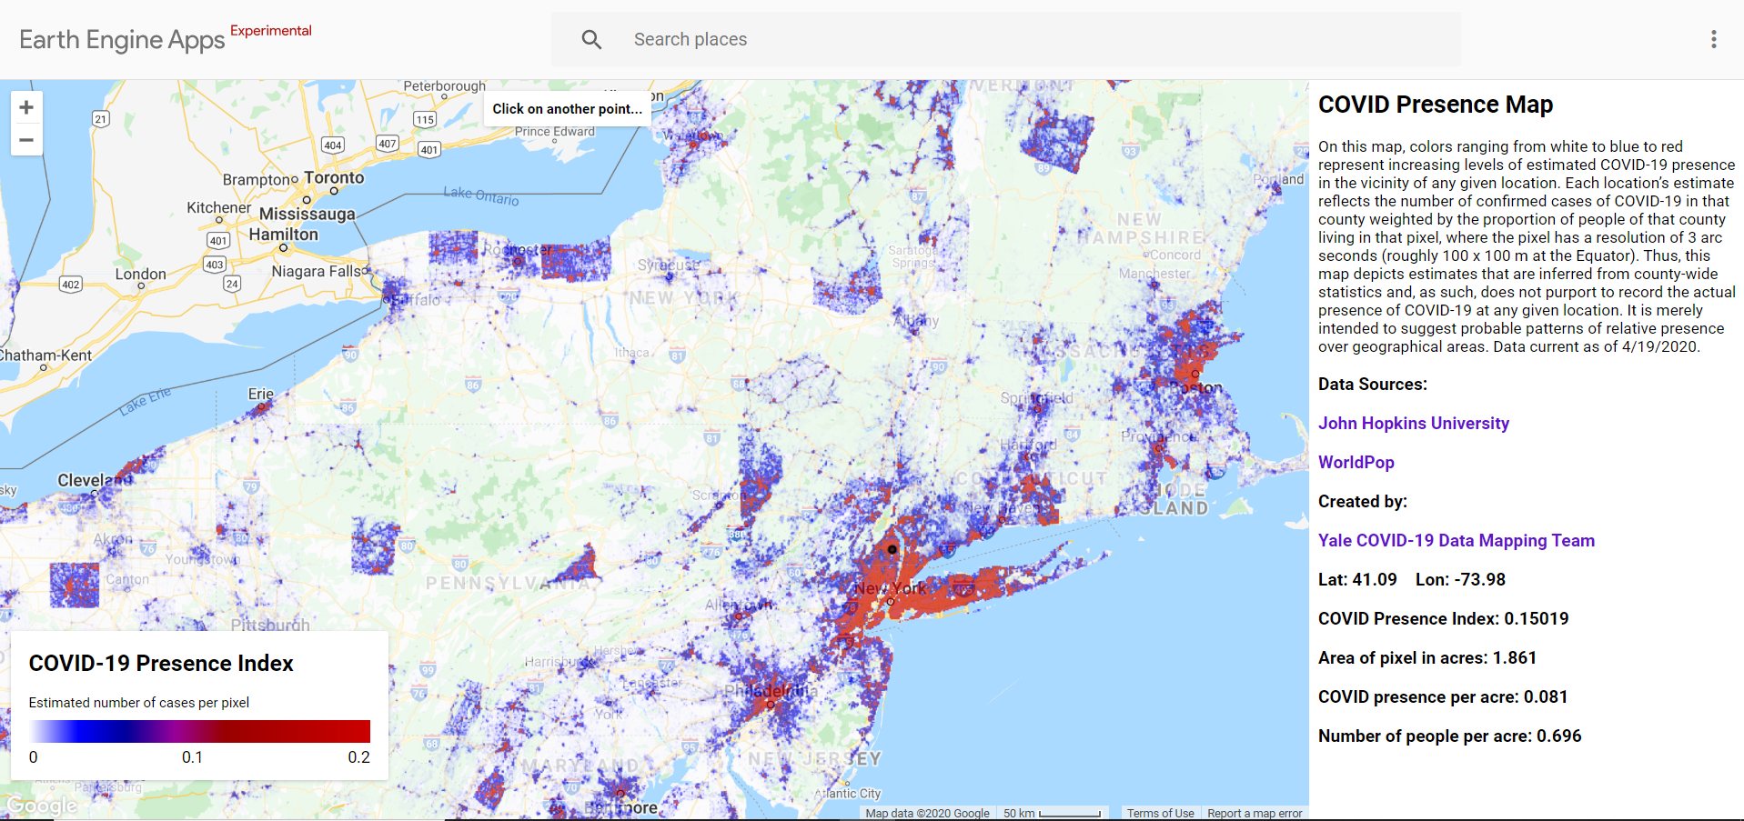
https://yaleschoolofmedicine.users.earthengine.app/view/covidpresence

Slide 38
Background
Data Types & Models
Examples
JavaScript API + Code Editor
Example Workflow
Web Applications
Resources
____

Slide 39
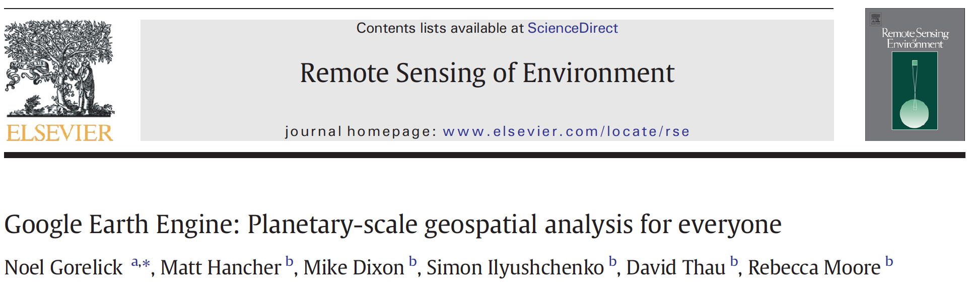
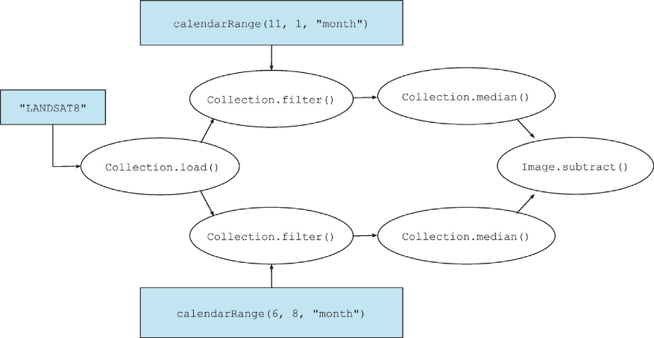
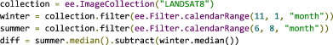
https://www.sciencedirect.com/science/article/pii/S0034425717302900

Slide 40
Resources
Geospatial Software Design
Google Earth Engine API documentation
Google Earth Engine Developers forum
GIS Stack Exchange
Community Tutorials
Example scripts from Prof. Dana Tomlin's handouts for his course on Geospatial Software Design
Earth Engine @ Yale Earth Engine Virtual Meetup

Slide 41
Questions?
tc.chakraborty@pnnl.gov

